Slide 1


SMART INDIA HACKATHON 2020
PROBLEM STATEMENT- Detection of Child Predators/ Cyber Harassers on Social Media
PROBLEM ID- RK307
MINISTRY/ ORGANISATION- Bureau of Police Research & Development
DOMAIN- Security and Surveillance

Slide 2

PREVENTION OF EMOTIONAL ENTRAPMENT OF GIRLS ON SOCIAL MEDIA PLATFORMS
Madras Institute Of Technology Campus
Anna University
Team SPHYNX
Members-
Kirupalini S
Gowri S Swetha S
Amruthavarshini R
Gayathri Rengarajan
Aditi Baskar
Mentors-
Dr. D Sangeetha (Academia)
Vignesh Sankaran (Industry- Pentafox)

Slide 3
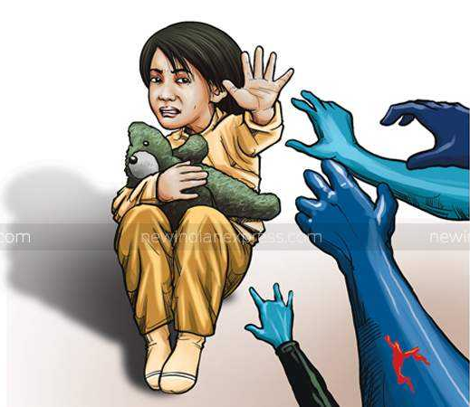
WHAT IS GROOMING?
Stages involved-
Friendship forming
Relationship forming
Risk assessment
Exclusivity
Sexual stage
Conclusion

Slide 4

WHY THIS PROBLEM STATEMENT?
Over the last couple of years the number of users, especially teens, on the internet has been on a rise.
https://wearesocial.com/blog/2020/01/digital-2020-3-8-billion-people-use-social-media

Slide 5
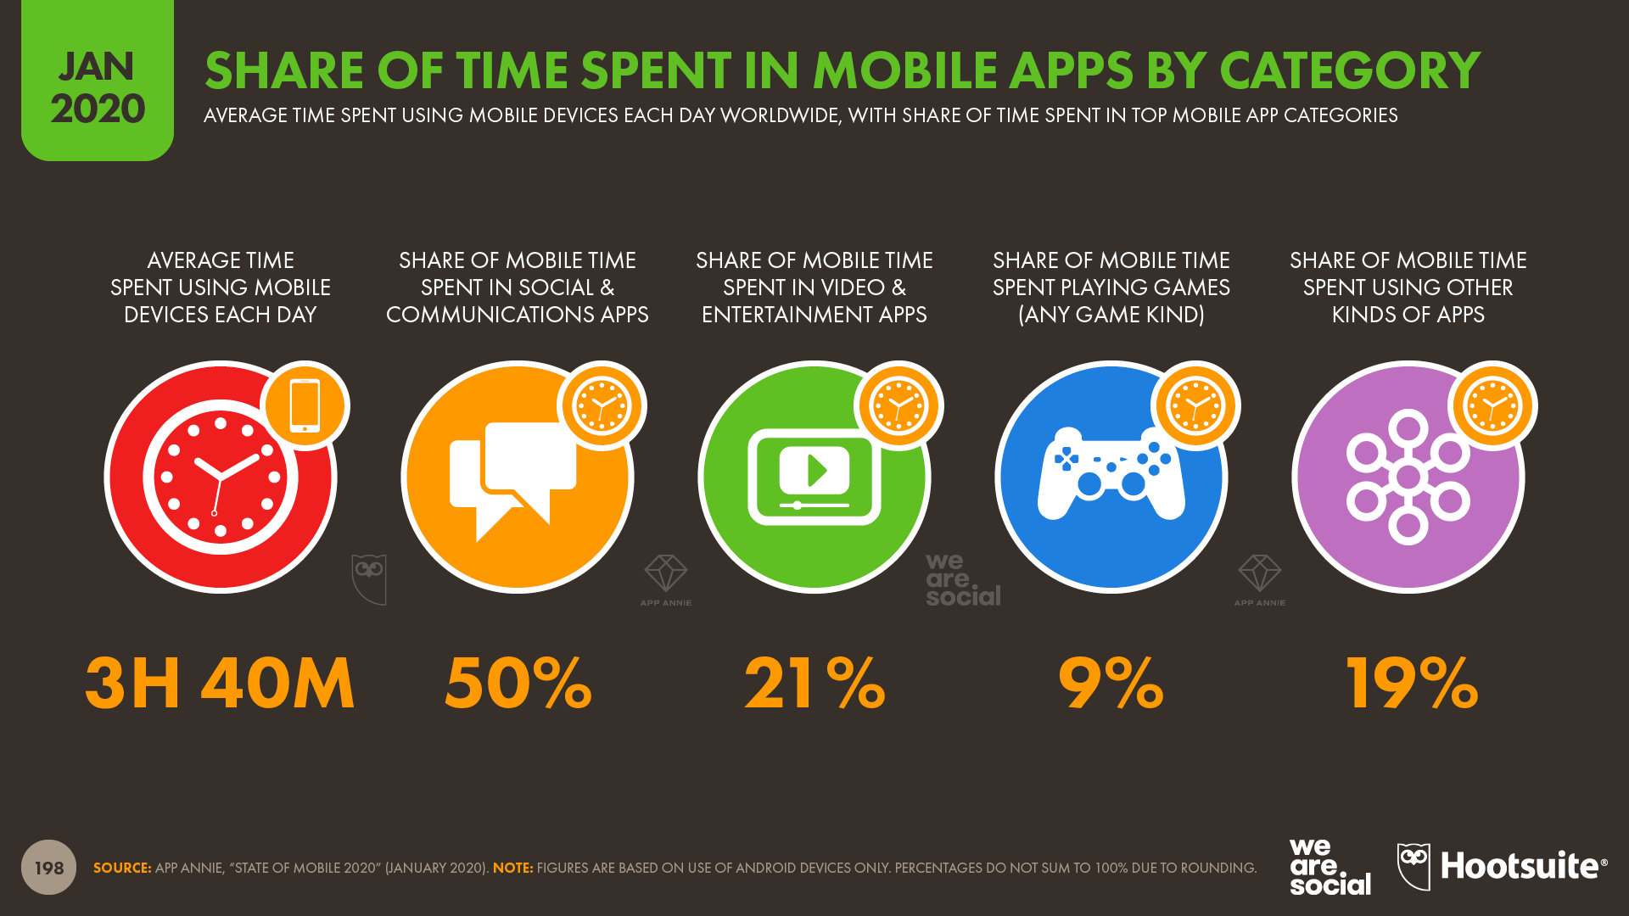
According to recent stats, mobile users spend most of their time on social media and chat based platforms.
https://wearesocial.com/blog/2020/01/digital-2020-3-8-billion-people-use-social-media

Slide 6
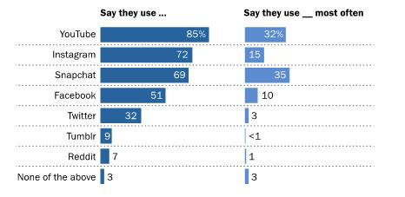
Presence of teens on various social media platforms.
http://actforyouth.net/adolescence/demographics/internet.cfm

Slide 7
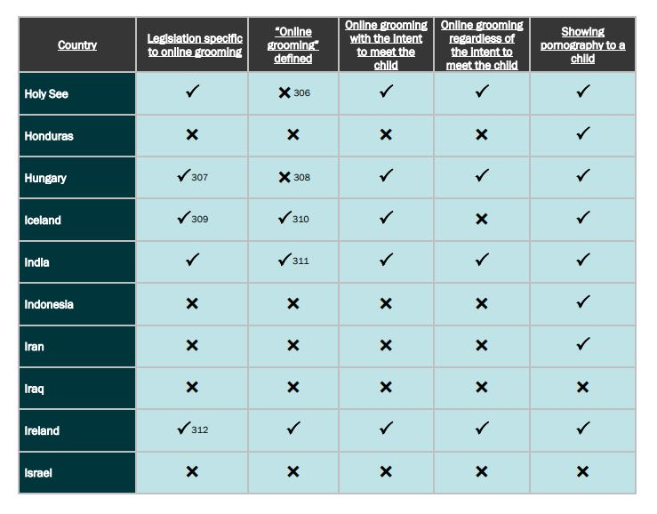
311- Section 67B of the Information Technology (Amendment) Act of India (2008) defines the acts constituting online grooming.
Online grooming of children is most prevalent within the 13–17 age group (99% of cases).
Particularly 13–14 (48%).
The majority of targeted children are girls.
Instagram was used in 32% of the 1,317 cases, Facebook in 23% and Snapchat in 14%.
https://www.bienestaryproteccioninfantil.es/imagenes/tablaContenidos03SubSec/Online-Grooming-of-Children_FINAL_9-18-17.pdf

Slide 8
AIM AND SCOPE
AIM:
To detect and report paedophilic activities on social media platforms through continuous monitoring. Once such characteristics are detected, an e-mail will be sent to immediate responders so as to facilitate further legal action against the reported paedophile.
SCOPE:
To scale up the prototype, with some additional features with regards to transliteration, so as to incorporate this software in real time platforms.

Slide 9




PROPOSED SOLUTION
The two modules used to tackle this problem are-
Age Verification
Grooming Detection
Age verification
Filtering users
Continuous monitoring
Alert authorities

Slide 10
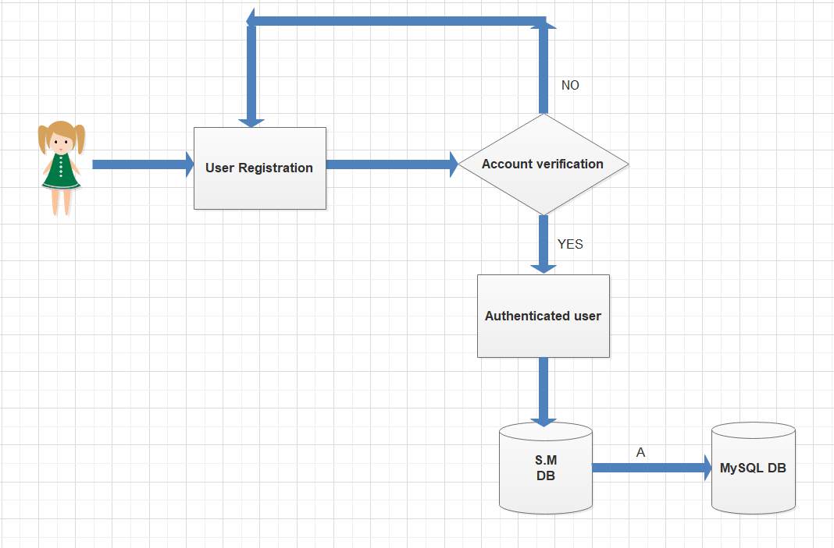
WORKFLOW
KEY:
S.M DB- Social Media Database
A- Filtered users

Slide 11
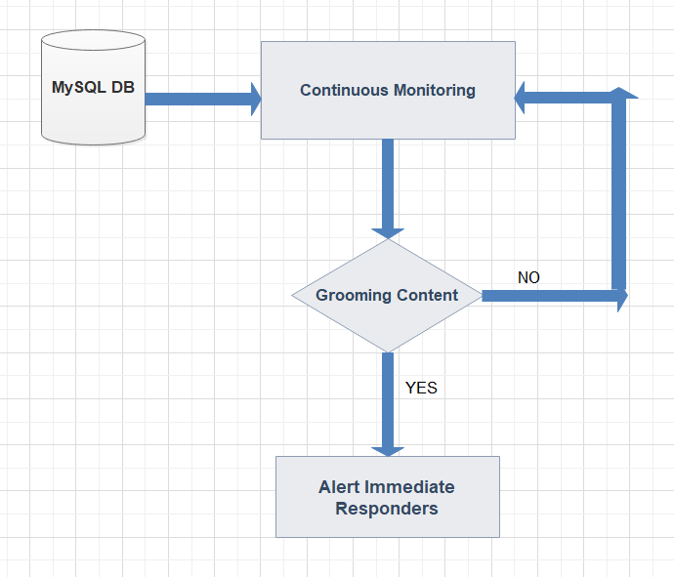

Slide 12
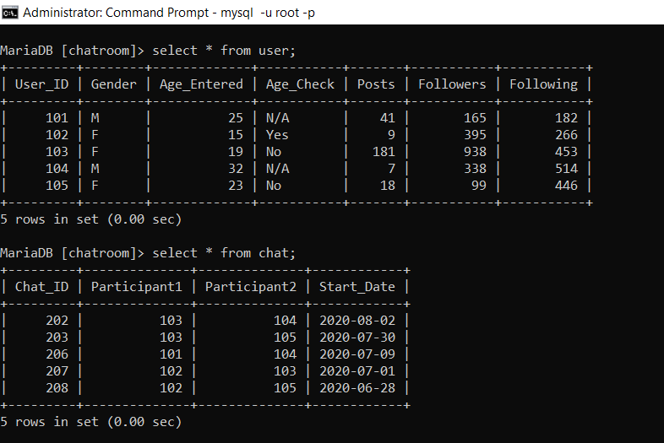
SCREENSHOTS
INITIAL DATABASE WITH USER RECORDS

Slide 13
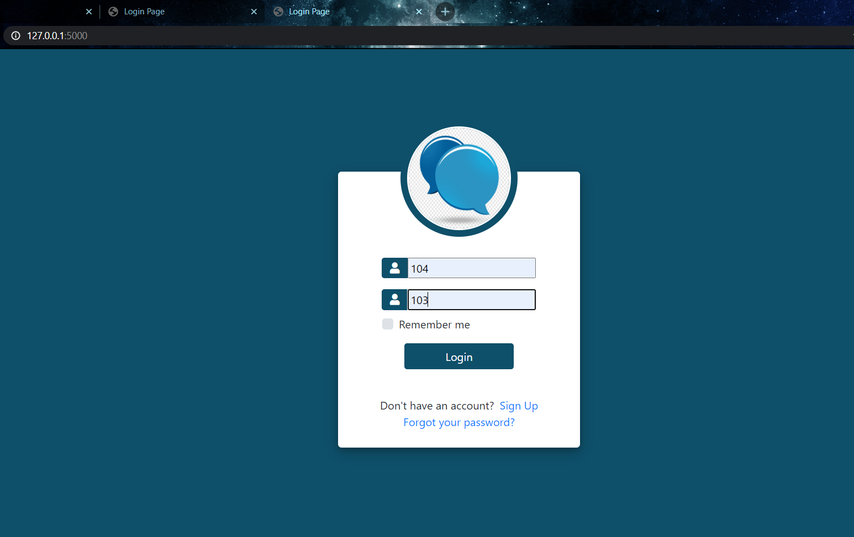

LOGIN PAGE
Participant 1
Participant 2

Slide 14
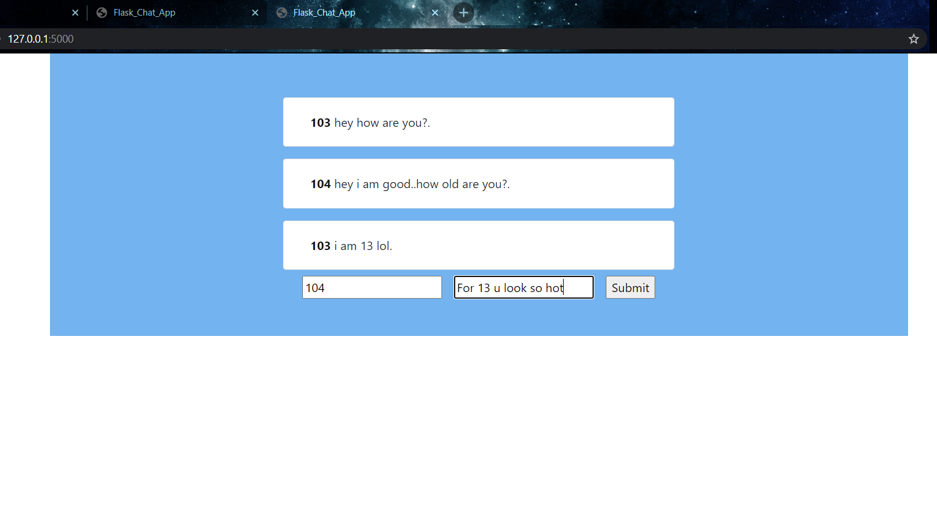
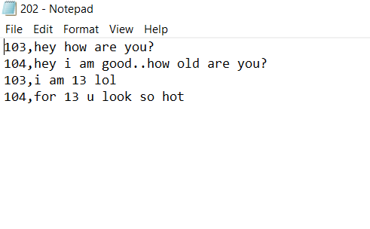
Chats are stored for two weeks for age detection

Slide 15
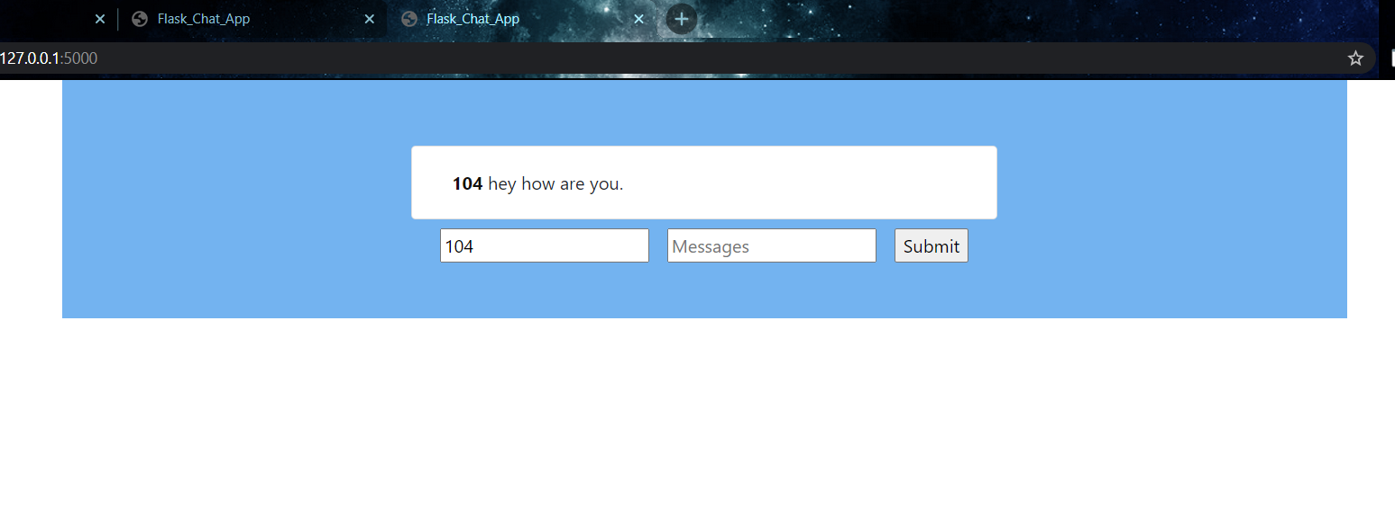
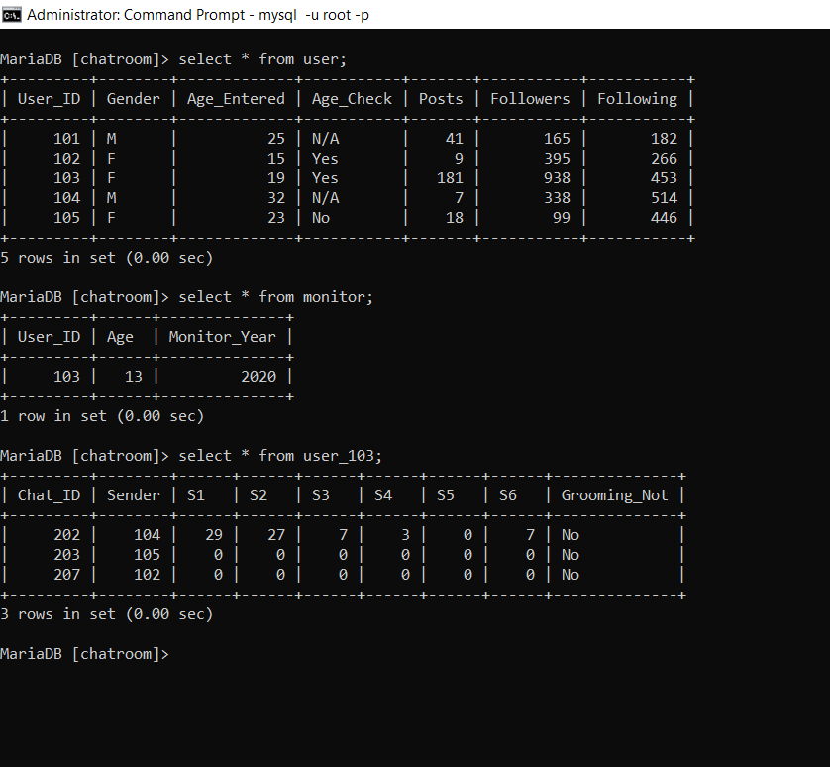
At the end of two weeks age is verified

Slide 16
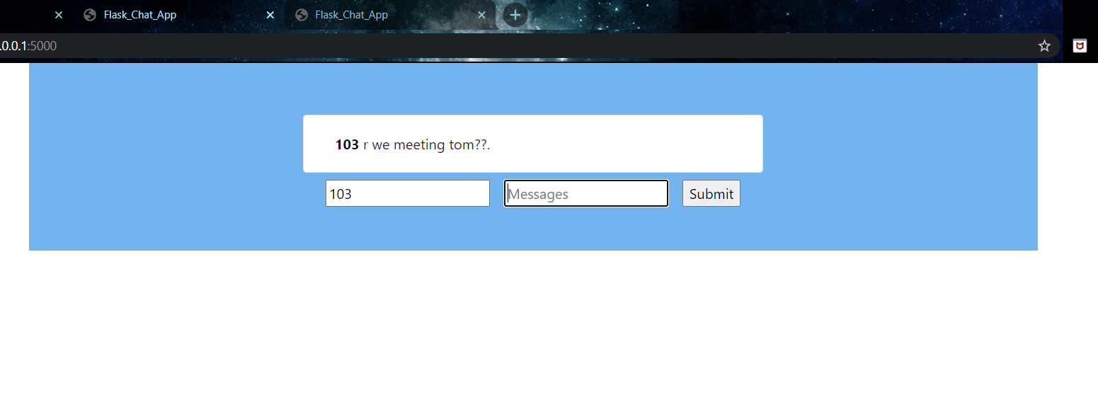

At the end of grooming process

Slide 17
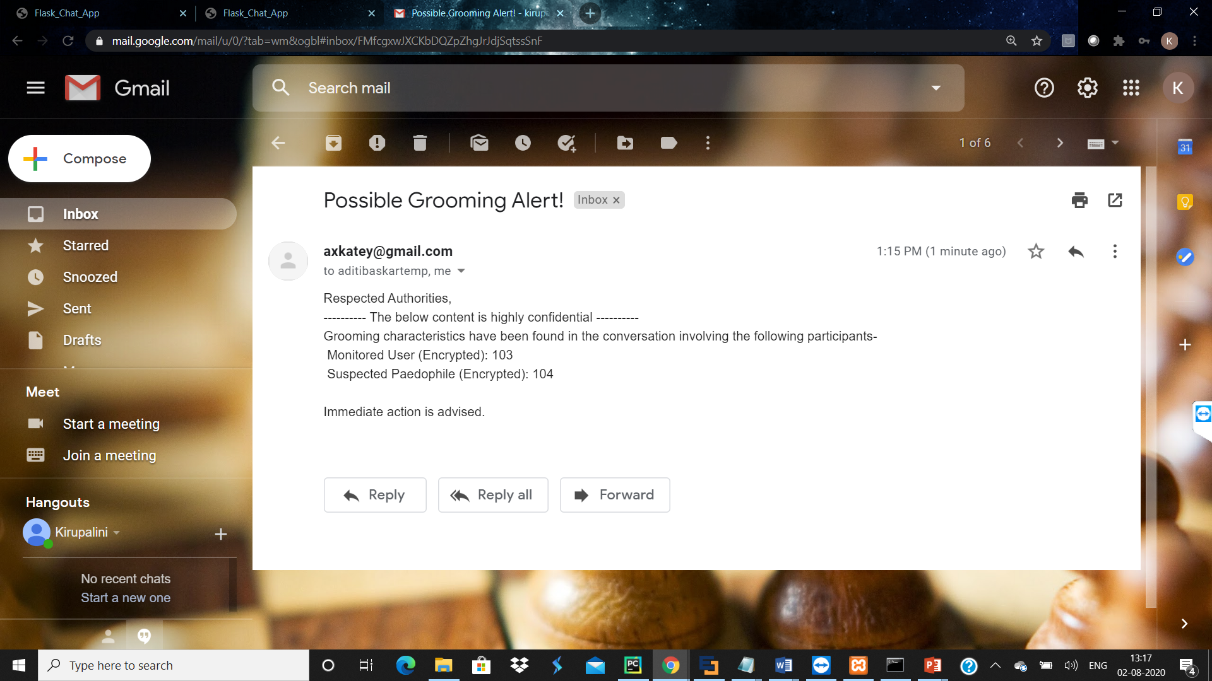
ALERT POLICE AUTHORITIES

Slide 18
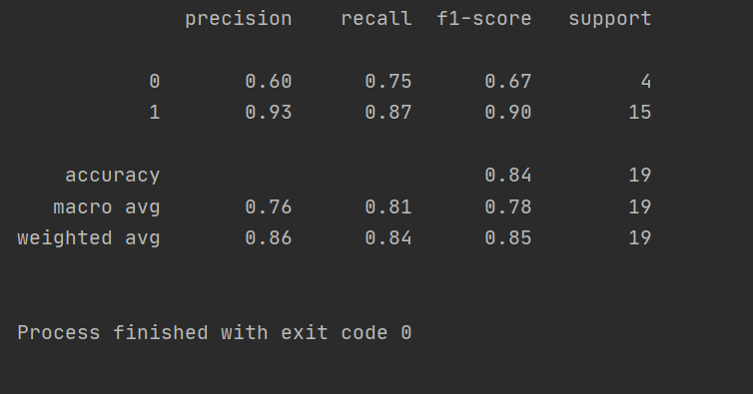
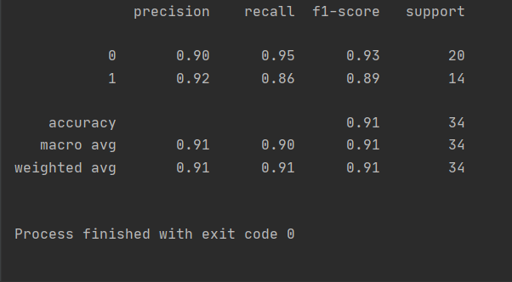
RESULTS
Age Detection
Grooming Detection

Slide 19
CHALLENGES
Privacy invasion
Accuracy in Transliteration of Dataset
Network challenges
End to end encryption ()
Bias

Slide 20
DATASET
The following organisations have been contacted in pursuit of regional dataset-
Bureau of Police Research and Development
National Crime Records Bureau
Prajwala

Slide 21
MILESTONES
Transliteration- dataset
Identify chat bots mimicking children
Create a gender and age detection module with input as photo.

Slide 22
CHAT BOT

Slide 23
THANK YOU

